Slide 1
STRATEGY FORMULATION
Strategic formulation is the process to develop a strategy for a business or an organization.
The resulting strategy should be in line with the vision of the business and will be adopted for the long term.
Strategy formulation is the development of long-range plans for the effective management of environment opportunities and threats in light of corporate strength and weakness.

Slide 2
Process of strategy formulation:
Review of strategic elements: Review of strategic elements such as mission, objectives, strategies and policies is the starting point of strategy formulation.
-Mission is the basic reasons for the organization's existence. It provides the basic philosophy of what the organization is all about.
Objectives are the end results of planned activities. They state what is to be accomplished by the organization.
Strategies are the comprehensive master plan stating how the organization will achieve its mission and objectives.
Policies are the broad guidelines for actions and decisions that links formulation of strategies with their implementation.
Before formulating strategies, above stated strategic elements should be reviewed. They should be restated or redefined, if necessary.

Slide 3
2. SWOT Analysis
3. Identification of strategic options
4. Evaluation of strategic options
5. Selection of Strategy

Slide 4
The Industry life cycle:
As organizations compete with one another, the competitive dynamics change. There is a change in the number of competitors, the competitive thrust, profitability, intensity of rivalry, and the emphasis on innovation.
These changes have been shown in the industry life cycle, which is an S-shaped curve similar to the product life cycle curve. The main life stages are – embryonic (Introduction), growth, shakeout, maturity, and decline.

Slide 5
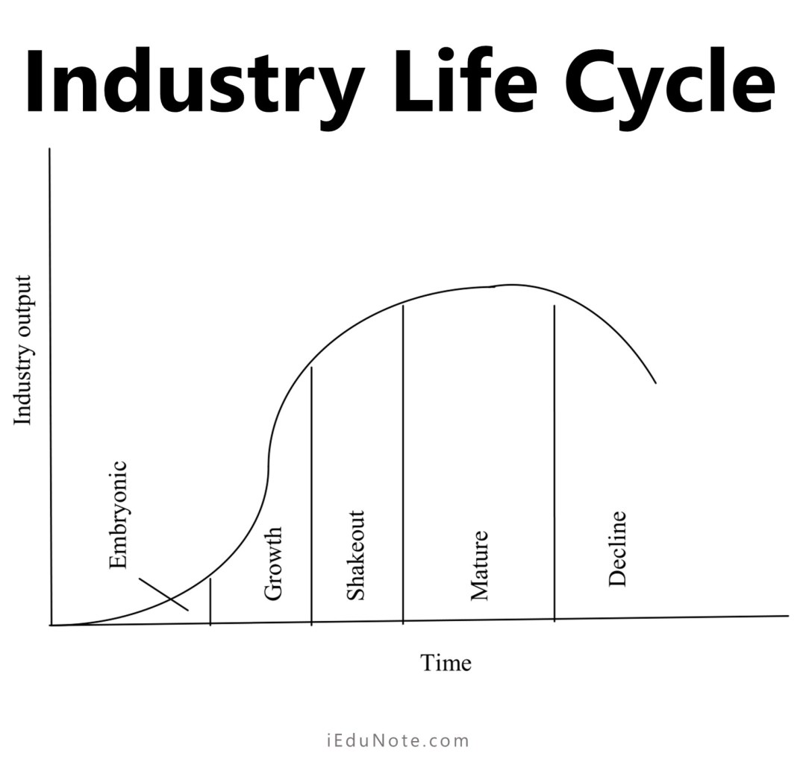

Slide 6
a. Introduction/Embryonic Firms :
In the introduction stage , business creating awareness about the product/service and educating the customers.
At the introduction stage, where the firm’s competition is none or very low, innovation is at maximum, and investment in distribution channels and marketing is very high. If a firm can develop proper distribution channels, increase consumer awareness, and provide a better quality product or service, then the rest of the competition will see sales numbers grow.
So at the introduction/embryonic stage;
innovation is the highest,
high focus on distribution channels,
large investment in marketing to establish consumer awareness

Slide 7
b. Growth:
At this stage, a strong firm’s growth rate of sales and market share accelerates. A standard for the product is imposed or agreed upon by the government and other standard-setting agencies. The innovation process is looking for ways to improve the existing product by creating a better manufacturing process, delivery method, and more. Firms try to optimize their marketing, distribution channel, and product to maximize the market share and reduce competition.
So at the growth stage;
sales rate increases for strong firms,
market share grows,
industry standards are set,
innovation is for making existing products better.

Slide 8
C. Shakeout:
During the shakeout stage of the cycle, the percentage growth rate declines. Firms face competition for market share from other firms. Firms that are weak in their innovation, marketing, customer support, product quality, and after-sales support; start to lose market share and eventually are forced out of the industry. On the other hand, strong firms start to gain more market share. At this stage, competitors have a fierce battle based on price wars; capacity within the industry grows, but the demand does not keep pace. Unviable organizations lose out in this phase.
So at the shakeout stage;
strong firms start to gain more market share,
and strong innovation, marketing, customer support, product quality, and after-sales support are needed to increase sales,
Competition increases and companies use marketing and pricing techniques to grow among the competition.

Slide 9
d. Maturity:
At this stage, the market reached the maximum size where industry growth is likely zero or negative. Companies that are strong in policy and sales numbers survive and totally dominate the marketplace. The market situation basically becomes an oligopoly where only a few large firms exist. Sales numbers are due to replacement, repeat purchases, there is no other alternative, or people looking to buy older generation products to save a few bucks.
In the maturity stage;
Consumer awareness is maximum,
The firm enjoys an oligopoly market,
Alternatives of the product are little or no,
Industry growth is flat.

Slide 10
e. Decline:
At this stage, the sales number drops to very low. This drop-in sale could be because of the internal and external environments such as;
A new alternative product has immersed, Rules and regulations changes,
Issues with the supply of raw materials,
Increased level of competition from other firms and more.
In the decline stage; a firm has four strategic options; Exit, Harvest, Maintain, and Consolidate.

Slide 11
Business Strategy:
Corporate-level strategy: This strategy is implemented at the highest level of the company. Company executives look at ways to improve and expand the company. They might identify additional markets they can enter.
Business-level strategy: This strategy focuses on how corporate aspirations will be implemented within individual company settings.
Functional-level strategy: This strategy focuses on the individual tasks of departments and employees in working toward corporate goals.

Slide 12
Types of corporate level strategy:
Stability strategy:
The stability strategy is a strategy that tries to keep an organization’s existing activities going without making any significant changes in direction. Maintaining existing products, markets, and operations is a priority.
A stability strategy can be beneficial in the short term, but it can be harmful if used for an extended period of time.
B. Expansion/Growth Strategy
The growth strategy aims to increase sales, assets, profits, or a combination of the three. It allows businesses to take advantage of the growth curve and lower the per-unit cost of products sold, resulting in higher profitability.
Due to the increased availability of financial resources, organizational procedures, and external links, larger organizations tend to endure longer than smaller companies.

Slide 13
Following are the strategic alternative under growth strategy;
1.Concentration Strategy:
A concentration strategy is when a business focuses on a specific group of clients, a specific product, or a specific geographic market. As the name implies, the primary purpose is to allow the business to concentrate (rather than diversify) their efforts. The idea is that this concentrated effort is more likely to yield expertise, innovation, and efficiencies within the area of concentration.
The two basic concentration strategy are vertical and horizontal growth.
Vertical growth: It can be achieved by taking over a function previously provided by a supplier or by a distributors.
Horizontal growth: It can be achieved by expanding the organizational operation into geographic locations or by increasing the range of products.

Slide 14
2. Diversification: It is a decision to enter into new business. The basic two diversification strategy are; concentric and conglomerate diversification.
Concentric diversification:
Concentric diversification is when your business starts producing products that are similar in the type of technology or expertise it requires to produce them.
Coca-Cola company develops the soft drinks and the company produce the chocolate of same flavor.
Conglomerate Diversification:
Conglomerate diversification is when your business develops products that are completely unrelated to its current product offering.
If pizza outlet owner decides to open a car showroom or decides to build residential houses than this is an example of conglomerate diversification as pizza outlet owner is moving to a completely different business from his or her current food business.

Slide 15
Implementing Growth Strategies:
1.Internal development:
Internal growth strategy seeks to optimize internal business processes to increase revenue. Similar to organic growth, this strategy relies on companies using their own internal resources.
Internal growth strategy is all about using existing resources in the most purposeful way possible.
An example of internal growth could be cutting wasteful spending and running a leaner operation by automating some of its functions instead of hiring more employees.
Internal growth can be more challenging because it forces companies to look at how their processes can be improved and made more efficient rather than focusing on external factors like entering new markets to facilitate growth.

Slide 16
2. Acquisition and Merger:
Merger and Acquisition is a strategy that is applied by businesses when they see the benefits of merging or acquiring firms. In the process, the bigger companies in the market hunt for smaller companies for the acquisition process.
Companies have different policies for mergers & acquisitions like expanding an existing business, research, development, etc. Failure to implement proper planning, study, and lack of strategies, also fails the merger & acquisition strategy. The resulting company cannot survive in the long run.

Slide 17
Merger can be horizontal, vertical or conglomerate
a. Vertical Strategy
This is the strategy where one company chooses to merge with or acquire another firm that is part of the same supply chain but operates at a different stage. These two entities merge and integrate the items they offer to consumers. For example, a car manufacturing company A merges with the same car distributor company B which becomes operational at a later stage.
b. Horizontal Strategy
This strategy is evident when one company merges with or acquires another firm that operates in the same domain. It is normally a measure adopted to reduce competition in the market.

Slide 18
c. Conglomerate Strategy
This strategy is observed to be adopted when two companies operating in two completely different niches collaborate.
Reasons for acquisition and Merger:
Increased market power
Overcoming entry business
Increased speed to market
Low risk
Increased diversification
Reshaping the firms competitive scope
Learning and developing new capabilities

Slide 19
Strategic Alliance:
Strategic alliances refer to cooperative agreements between two or more organizations to pursue common goals while maintaining their individual identities.
A strategic alliance is a partnership between two businesses to achieve mutual goals and growth, while still retaining independence.
The success from strategic alliance is more likely when partners behave cooperatively to solve mutual problems.
Strategic alliance may be Joint venture, Equity alliance, Non-equity alliance.

Slide 20
Reasons for strategic alliance:
To obtain or learn new capabilities
To obtain access to specific markets
To reduce financial risk
To reduce political risk
Co-specialization
Components for the success of strategic alliance
Trust
Top management support
Performance expectation
Clear goal and organizational arrangement
Compatibility
Evolve and change

Slide 21
C. Retrenchment Strategy
A retrenchment strategy is a business approach that tries to diminish a company’s size or diversity.
Retrench strategy is adopted when the company not doing well, when an organization’s survival is threatened and it is not competing well. It involves contraction of the scope or level of business or function.
It is also called defensive strategy.
At very first, retrenchment entails selling of fixed properties to raise needed fund, cutting weaker product line or marginal business, reduce the number of employees and adaptation of expense control systems.
Turnaround Strategy:
Turnaround strategy can be referred as converting a loss making unit into a profitability one.

Slide 22
D. Combination/Mixed strategy
When an organization operates in a variety of environments, separate strategic business units and products follow a combination strategy.
In other words, a firm is said to be implementing a combination strategy if it uses stability, expansion, and retrenchment strategies in its many strategic business units at the same time.
It is primarily used to solve a variety of environmental issues.

Slide 23
Business level strategies/Generic competitive strategies:
1. Porters Competitive Strategy:
Michael Porter defines three strategy types that can attain a competitive advantage. These strategies are cost leadership, differentiation, and market segmentation (or focus).
Cost leadership strategy:
The Cost Leadership Strategy is a key concept in business strategy, focusing on achieving a competitive advantage by becoming the low-cost producer in a particular industry or market. This approach involves producing goods or delivering services at a lower cost compared to competitors while maintaining acceptable quality levels.

Slide 24
Porter’s Cost Leadership Strategy aims to achieve a competitive advantage by offering products or services at a lower cost than competitors while maintaining a reasonable level of quality to offer products at a price that is attractive to customers and allows the business to capture a significant market share.

Slide 25
Advantages of Cost Leadership Strategy | Disadvantages of Cost Leadership Strategy
Competitive Pricing: Attract price-sensitive customers. | Quality Trade-offs: Possible compromises in product quality or customer service.
Higher Market Share: Capture a larger portion of the market. | Dependence on Scale: Requires high production volume, disadvantaging smaller businesses.
Barriers to New Entrants: Deter competitors from matching low prices. | Imitation by Competitors: Successful strategies can be replicated by rivals.
Economies of Scale: Benefit from lower per-unit costs as production scales up. | Limited Price Flexibility: Difficulty in raising prices when necessary.
Operational Efficiency: Streamline processes and enhance overall efficiency. | Risk of Stagnation: Focus on cost-cutting may hinder innovation and adaptation.

Slide 26
Ways of cost reduction:
Economies of scale
Capacity utilization
Experience
Resource sharing
Low cost materials
Direct marketing
Simple product design and process
Condition of success of cost leadership strategy
High price competition
Standardized products
Price sensitive customer
Similar products
Low switching cost
High buyer power

Slide 27
2- Differentiation Strategy
The Differentiation Strategy is a fundamental concept within business strategy, focusing on gaining a competitive edge by offering unparalleled and distinct products or services that capture attention in the market.
Porter’s Differentiation Strategy seeks to create a competitive advantage by offering unique and distinct products or services customers view as superior in quality or features compared to competitors.
This strategy revolves around presenting customers with something extraordinary or appealing that distinguishes a business from its competitors. Through innovation, quality, branding, or enhancing the customer experience, companies can establish premium value and cultivate enduring customer loyalty.

Slide 28
Bases for Differentiation
Unique product performance
Unique product features
Unique services
Detailed information
Conditions for success of Differentiation strategy
Diversification of product use
Few rivals
Dynamic technological environment
Quality sensitive buyer
Extensive research

Slide 29
Advantages of Differentiation Strategy | Disadvantages of Differentiation Strategy
Brand Loyalty: Unique features and experiences foster strong customer loyalty. | High Costs: Investments in innovation, quality, and branding can lead to elevated production and operational costs.
Premium Pricing: Differentiation allows companies to charge premium prices. | Imitation Risk: Competitors may try to replicate successful differentiating features, potentially diluting uniqueness over time.
Reduced Price Sensitivity: Customers valuing distinct attributes are less price-sensitive. | Niche Market Focus: Targeting a specialized market may limit the potential customer base.
Market Resilience: Unique offerings provide stability during economic downturns. | Continuous Innovation Pressure: Sustaining differentiation demands ongoing innovation efforts and resource allocation.
Barriers to Entry: Substantial investment deters new entrants from replicating the differentiation. | Educating Customers: Unconventional offerings may require customer education about their unique value proposition.
Enhanced Brand Image: Differentiation often leads to an elevated brand reputation. | Price Pressure: Intense competition may compel companies to reduce prices, challenging premium positioning.

Slide 30
3- Focus Strategy
The Focus Strategy, a pivotal concept in business strategy, encompasses two distinct sub-strategies: Cost Focus and Differentiation Focus.
This strategy involves concentrating efforts on a specific market segment or niche to gain a competitive advantage. By tailoring products or services to serve the unique needs of this targeted group exceptionally well, companies can achieve heightened success within their chosen market.
Cost Focus: The Cost Focus sub-strategy within the Focus Strategy centers on serving a particular market niche with a primary focus on cost efficiency. Companies adopting this approach seek to offer products or services at lower costs than competitors, catering to the specific cost-conscious preferences of the targeted customer segment.

Slide 31
Differentiation Focus: The Differentiation Focus sub-strategy revolves around standing out within a specific market niche by offering distinctive and unique products or services. Companies following this approach invest in research, development, branding, and customer experience to create offerings that resonate exclusively with their target audience.

Slide 32
2. Strategic Clock Oriented Market based Strategies:
Bowman's Strategy Clock analyzes the competitive position of a company in comparison to the offerings of competitors. It was developed by Cliff Bowman and David Faulkner as an elaboration of the three Porter generic strategies.
It is important to understand how companies compete in the market place. It is a diagrammatic representation which shows the relationship between customer value and prices.

Slide 33
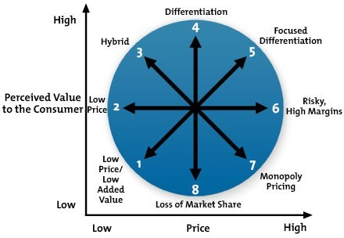

Slide 34
Position 1: Low Price & Low Value Added
This strategy is about quantity selling. The products or services are low in value and the price point is the lowest possible. The combination makes it the least competitive area on the Strategy Clock.
Position 2: Low Price
Low Price, as the name suggests, is a strategy about becoming the lowest cost option for buyers in the marketplace. It’s a strategy that can have low margins, so process efficiency and cost reduction is key for it to be successful. With this strategy, you’re aiming for high quantity levels, otherwise you can end up with low sales, low price – a fatal combination.

Slide 35
Position 3: Hybrid
The Hybrid position sits between low price and differentiation. It’s around ensuring the price is competitive, ideally with a low perceived price from buyers, while promoting the added value aspects of the product.
The success of the hybrid strategy comes down to the balance between cost and differentiation, attempting to maximise each while maintaining good margins.
Position 4: Differentiation
The Differentiation strategy is where a business focuses on differentiating their products or services from competitors by adding high perceived value. This strategy has a wide spectrum from full product diversity through to unique features within a core product.

Slide 36
Position 5: Focused Differentiation
Focused Differentiation is about providing high value at a high price (not to be confused with Porter’s Generic Strategy of the same name, which talks about going to a niche market). When successfully done, this strategy provides high profits but can be difficult to maintain – the iPhone launch and subsequent early growth is an example of this strategy.
Position 6: Risky High Margins
Any strategy that has the name Risky in it should mean you completely understand your options before you embark on it, of course! The main thrust of this strategy is to go in with a high price point without any perceived added value.

Slide 37
Position 7: Monopoly Pricing
In monopoly markets a single company controls the product and pricing, so other factors such as price points, value or competitors play less of a factor. Of course, all monopolies can come to an end – so these companies still need to keep an eye on their external factors.
Position 8: Loss of Market Share
This is generally the worst position to be in and suggests that the company is exiting the market or is in decline. It may be that they have chosen this strategy as part of a move to newer markets, or it may be forced upon them due to getting their price or market fit incorrect.

Slide 38
Portfolio Analysis for Strategic Choice:
Portfolio analysis is a set of techniques that helps the managers in taking strategic decisions with regard to individual products or businesses in a firm's portfolio. Portfolio analysis examines the balance of an organization's SBUs. It is a key aspect of strategic capability to ensure that the portfolio is strong. Portfolio analysis can be used to describe the current range of SBUs and to assess the ‘strength’ of the mix both historically and against future scenarios. Since mid 1960s, various tools have been developed for portfolio analysis. Out of them, following are the important and most used tools for portfolio analysis; ⦁ BCG Matrix ⦁ GE Nine-cell Matrix ⦁ Hofer's Matrix

Slide 39
BCG Matrix:
Boston Consulting Group (BCG) Matrix is a four celled matrix (a 2 * 2 matrix) developed by BCG, USA. It is the most renowned corporate portfolio analysis tool.
It provides a graphic representation for an organization to examine different businesses in it's portfolio on the basis of their related market share and industry growth rates. It is a two dimensional analysis on management of SBU's (Strategic Business Units).
In other words, it is a comparative analysis of business potential and the evaluation of environment. According to this matrix, business could be classified as high or low according to their industry growth rate and relative market share

Slide 40
Relative Market Share = SBU Sales this year leading competitors sales this year.
Market Growth Rate = Industry sales this year - Industry Sales last year.
BCG matrix has four cells, with the horizontal axis representing relative market share and the vertical axis denoting market growth rate. Resources are allocated to the business units according to their situation on the grid.
The four cells of this matrix have been called as stars, cash cows, question marks and dogs. Each of these cells represents a particular type of business.

Slide 41
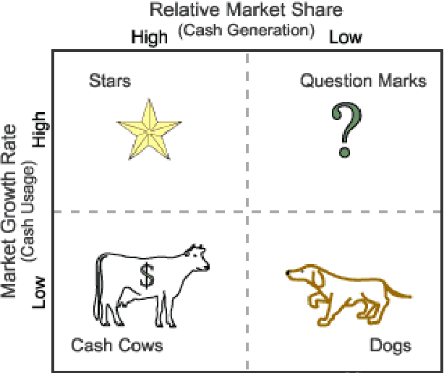

Slide 42
Stars: Stars represent business units having large market share in a fast growing industry. They may generate cash but because of fast growing market, stars require huge investments to maintain their lead. Net cash flow is usually modest. SBU's located in this cell are attractive as they are located in a robust industry and these business units are highly competitive in the industry. If successful, a star will become a cash cow when the industry matures.

Slide 43
Cash Cows: Cash Cows represents business units having a large market share in a mature, slow growing industry. Cash cows require little investment and generate cash that can be utilized for investment in other business units. These SBU's are the corporation's key source of cash, and are specifically the core business. They are the base of an organization. These businesses usually follow stability strategies. When cash cows loose their appeal and move towards deterioration, then a retrenchment policy may be pursued

Slide 44
Question Marks: Question marks represent business units having low relative market share and located in a high growth industry. They require huge amount of cash to maintain or gain market share. They require attention to determine if the venture can be viable.
Question marks are generally new goods and services which have a good commercial prospective. There is no specific strategy which can be adopted. If the firm thinks it has dominant market share, then it can adopt expansion strategy, else retrenchment strategy can be adopted.
Most businesses start as question marks as the company tries to enter a high growth market in which there is already a market-share. If ignored, then question marks may become dogs, while if huge investment is made, then they have potential of becoming stars.

Slide 45
Dogs: Dogs represent businesses having weak market shares in low-growth markets. They neither generate cash nor require huge amount of cash. Due to low market share, these business units face cost disadvantages.
Generally retrenchment strategies are adopted because these firms can gain market share only at the expense of competitor's/rival firms. These business firms have weak market share because of high costs, poor quality, ineffective marketing, etc.
Unless a dog has some other strategic aim, it should be liquidated if there is fewer prospects for it to gain market share. Number of dogs should be avoided and minimized in an organization.

Slide 46
Generic Electric Matrix:
In 1970, General Electric (GE) commissioned Mc Kinsey and company to develop a portfolio analysis matrix for screening its business units.
GE Nine cell matrix is a strategy tool that offers a systematic approach for the multi business enterprises to prioritize their investment among the various business units. It is a framework that evaluates business portfolio and provides further strategic implications.
This matrix has also many points in common with the MABA analysis. MABA is an acronym that stands Market, Attractiveness, Business Position and Assessment.

Slide 47
Industry attractiveness indicates how hard or easy it will be for a company to compete in the market and earn profits. The more profitable the industry is the more attractive it becomes. When evaluating the industry attractiveness, analysts should look how an industry will change in the long run rather than in the near future, because the investment need for the product usually require long lasting commitment.
Each business is appraised in terms of two major dimensions ; Market attractiveness and Business strength. If one of these factors is missing, then the business will not produce desired results. Neither a strong company operating in an unattractive market nor a weak company operating in an attractive market will do vey well.

Slide 48
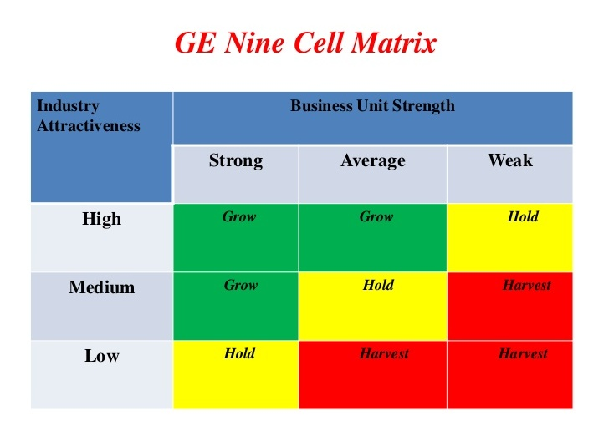

Slide 49
Green Zone Invest/grow:
Suggest you to ‘go ahead’ to grow and build punishing you through expansion strategies. Business in the green zone attract major investment.
Yellow Zone/ hold:
Cautions you to ‘wait and see’ indicating hold and maintain types of strategies aimed a stability.
Red Zone Harvest/ sell:
Indicates that you have to adopt turnover strategies of divestment and liquidation or rebuilding approach.

Slide 50
Advantage of GE Matrix:
It provides a clear and simple framework for analyzing a company's portfolio of products or business units.
It helps companies identify which business units or products are strong and which are weak, so they can allocate resources accordingly.
It helps companies identify growth opportunities and potential problem areas.
It can be used to assess the impact of strategic changes, such as mergers and acquisitions, on a company's portfolio.
It is useful for both large and small companies.
It's easy to understand for non-expert stakeholders.
It helps to prioritize resources allocation and investment on business units or products.

Slide 51
Disadvantages of BCG Matrices
It only considers market growth and market share, ignoring other important factors such as profitability, competition, and industry trends.
It is based on the assumption that market growth and market share are the only drivers of a business unit's success, which may not be accurate in all cases.
It does not take into account the potential for future growth, which can lead to the company investing in a business unit that has limited potential for growth.
It may lead to a company investing too much in one area and neglecting other areas of the business.
It may be too simplistic to accurately reflect the complex realities of a business.
It may lead to a company neglecting or divesting from a business unit that could be turned around with the right investments.
It does not account for the company's unique strengths, weaknesses, opportunities and threats.

Slide 52
BCG Matrix | GE Matrix
Focuses on market share and market growth | Focuses on market attractiveness and business strength
Uses a 2x2 matrix with quadrants for "Stars," "Cash Cows," "Dogs," and "Question Marks" | Uses a multi-factor matrix with 9 cells, each representing a different strategic position
Useful for evaluating the portfolio of a company's existing businesses | Useful for evaluating potential new businesses or product lines
Typically used in mature industries | Can be used in both mature and emerging industries
Developed by the Boston Consulting Group in the 1970s | Developed by General Electric in the 1960s

Slide 53
Evaluation of strategy Alternatives:
The criteria used for evaluation of strategic alternatives are:
1. Suitability
It is concerned with environmental fit of the strategic alternative. It also provides the rationale to a strategy. It indicate whether the strategic alternative make sense in relation to environmental circumstances. It is also a basic of qualitative assessment concerned with testing out the rational of strategy and is useful for screening options. The assessment of suitability consists of two stages.
Screening Options for suitability: The methods used for understanding suitability are ranking, decision tree and scenarios.

Slide 54
2. Acceptability
It is concerned with the expected performance outcomes of a strategic alternative. It is strongly related to people expectations and therefore the issues of require careful analysis. The criteria for acceptability of strategic alternative are
i. Return
Expected return from specific strategic options is assessed. The various approaches to analyze return are
Profitability analysis: It assesses financial return to investment. The tools used for this analysis are return on capital employed, payback period, and discounted cash flow.
Cost benefit analysis: It assesses the overall economic impact of strategic options. This analysis attempts to put a money value of all the costs and benefits of strategic options.
Shareholder value analysis: It assesses the impact of strategic options in generating shareholders value. The shareholder value is the total shareholder return.

Slide 55
ii. Risks
It involves probably estimate about robustness of strategic The level of risk is important for acceptability of strategic options. New product development carries high level of risks. The approaches for analyzing risks are.
Financial ratio
Sensitivity analysis
iii. Stakeholder expectation
It provides political dimensions to the organizations acceptability of a strategic alternative. The approaches of stakeholder are
Stakeholder mapping
Game theory.

Slide 56
3. Feasibility
It is concerned with availability of resources and competencies to deliver strategic alternatives. It determines an option implement ability and work ability in practice. It assesses the organizations capability to make the strategic alternatives succeed. The approaches for available to understand feasibility are;
Funds flow analysis: It assesses financial feasibility. It forecasts the funds required and the likely resources of funds for strategic alternatives.
Break even analysis: It studies costs volume profit relationships to assess financial feasibility. This analysis identifies BEP when revenue equal costs.
Resource deployment analysis: It identifies need for resources and competencies for specific strategic alternatives. It is used to judge the
Sufficiency of current resources and competencies to pursue strategic options.
Need for unique resources and competencies to sustain strategic advantages.

